Slide 1



08/12/23
+
Dept. of CEA
Cherub Singh
Gauri Verma
Kartikay Mittal
Mayur Varshney
INTELLIGENT
CAR
PARKING MANAGEMENT
SYSTEM

Slide 2


Introduction
Intelligent Car Parking Management System, redefines parking solutions through innovative technology. The system streamlines operations and enhances user experience, addressing challenges in traditional parking management. We’ll showcase a transformative solution designed to streamline parking, improve user experience, and address conventional management challenges. Our goal is to contribute to the advancement of intelligent systems and provide a transformative solution to real-world parking issues.

Slide 3

Objectives
1. Create a system that provides real-time information on available parking spaces.
2. Develop a web-based dashboard for parking space administrators to monitor occupancy and optimize space allocation to help drivers locate and reserve parking spots.
3. Reduce traffic congestion and environmental impact by optimizing parking space utilization.
We aim to propel the progress of intelligent systems, offering a groundbreaking solution to practical parking challenges.

Slide 4

Problem Statement
In urban areas, parking scarcity is a significant issue that contributes to traffic congestion, wasted fuel, and driver frustration. The traditional method of manually searching for vacant parking spaces is time-consuming, and inefficient, and can lead to increased emissions due to excessive vehicle maneuvering. To address this challenge, an intelligent car parking management system using IoT sensors is proposed.

Slide 5

Literature Review
Infrared (IR) sensors are a key component of modern home security systems. They are affordable, easy to install, and effective at detecting motion, even in low-light conditions. IR sensors can be used for a variety of purposes, including motion detection alarms, perimeter security, and automatic lighting control. They can also be used with smart home systems to provide remote monitoring and alerts. IR sensors work by emitting and detecting infrared radiation. This radiation is invisible to the human eye, but it can be reflected off of objects. When an object moves within the sensor’s field of view, the reflected radiation triggers an alert. This alert can be used to activate an alarm, turn on lights, or send a notification to a smartphone.

Slide 6
Gaps Filled:-
1) Inefficient Parking Search and Congestion: Intelligent Car Parking Management System (ICPMS) minimizes search time and optimizes parking space utilization, reducing congestion and wasted fuel consumption.
2) Limited Parking Availability Awareness: ICPMS provides real-time parking information, directing drivers to available spots and alleviating frustration.
3) Underutilized Parking Spaces: ICPMS employs IoT sensors to ensure efficient utilization of all parking spaces, preventing underutilization and maximizing revenue.
4) Enhanced Security and Monitoring: ICPMS incorporates surveillance, access control, and real-time monitoring to enhance security and prevent unauthorized access or incidents.

Slide 7

METHODOLOGY
In our project, we incorporated various sensors like IR sensors, a servo motor, and an LCD, all connected to an Arduino Uno, to enhance our parking area. IR sensors are strategically placed at entrance and exit gates to automatically open and close the gates upon detecting a vehicle. Additionally, IR sensors at parking slots help us monitor slot availability in real-time. A servo motor is employed to operate the gate based on the data received from the IR sensors near the gates. To provide users with information, we use an LCD, which shows the total number of parking slots and the currently available slots. This system simplifies parking management and enhances the overall user experience.

Slide 8
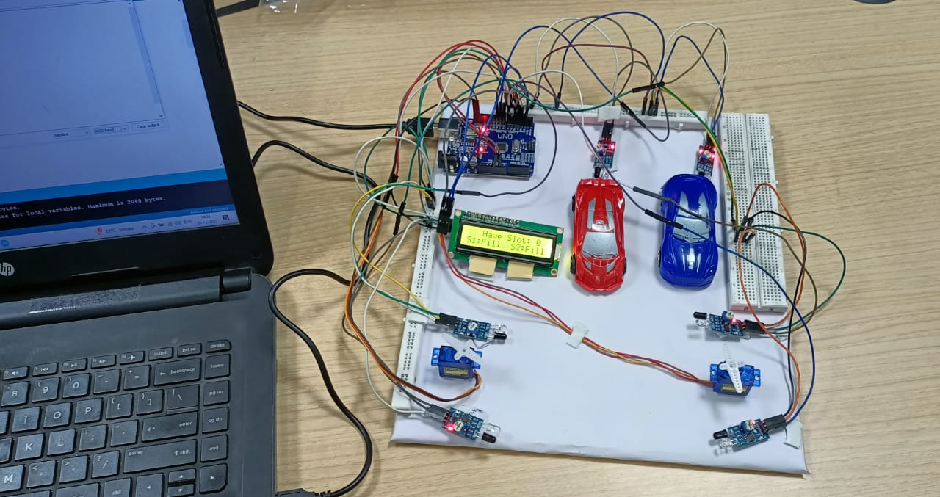
SYSTEM ARCHITECTURE
Overall Architecture:-
Components Used:-
1)Bread Board
2)IR Sensors{6}
3)Arduino UNO
4)ESP8266 (nodeMCU)
5)Servo Motor
6)LCD

Slide 9
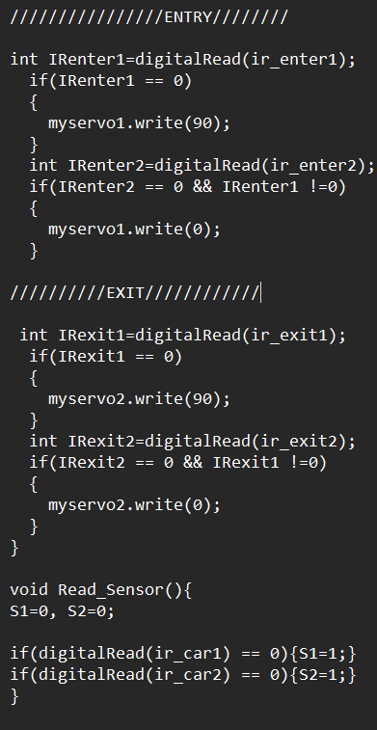
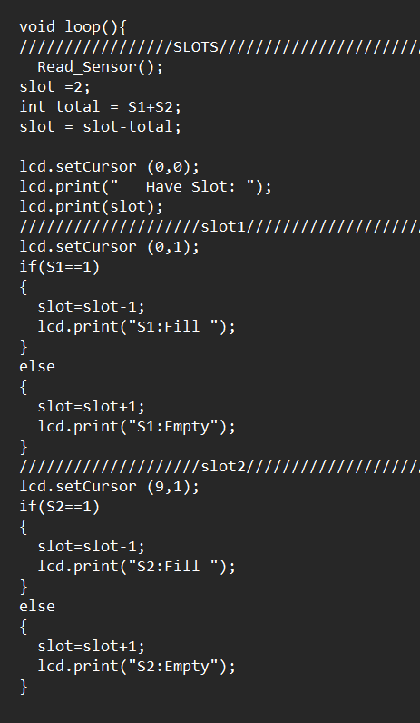
IMPLEMENTATION
1) Sensor installation: Deploy all the sensors in the designated parking area(1 week).
2) Integration: Integrate sensor data with the web page(1 week).
3) Software Development: Develop the web interface to display parking slot availability(1 week).
4)Testing: Conduct comprehensive testing to ensure the system’s proper functionality(4-5 days).

Slide 10

Features
1)Real-time Parking Availability: Drivers can check real-time parking space availability on the website before arriving at the parking lot.
2)Parking Space Monitoring: Administrators can view real-time occupancy data, receive alerts, and optimize space allocation using the web-based dashboard.
3)Environmental Impact Reduction: By reducing the time spent searching for parking, the system contributes to reduced traffic congestion and fuel savings.

Slide 11

Results
1)Real-time Parking Information: Implemented a system offering drivers instant updates on available parking spaces through mobile apps.
2)Efficient Parking with Reduced Search Times: Successfully reduced parking search times, enhancing the overall user experience and efficiency.
3)Comprehensive Space Management: Administrators now benefit from an advanced system for optimized parking space allocation and monitoring.
4)Potential for Traffic and Environmental Impact Reduction: The project holds promise for minimizing traffic congestion and environmental impact through streamlined parking processes.

Slide 12

Challenges Faced
1)Hardware Reliability: The reliability of hardware components, such as sensors, is essential for accurate data collection. Technical malfunctions occurred. We overcame them while testing and changing the sensor that was not working properly.
2)Integration Complexity:- At starting we found it a bit confusing how to integrate the real-time data with a web dashboard but after some research and optimization in our codes we overcame it.

Slide 13

Future Work
We may add up the following functionalities to make our parking system more commercial:-
1) Database Management Systems: To store and manage data related to parking spaces, reservations, payment transactions, and user profiles. Popular choices include SQL databases like MySQL or NoSQL databases like MongoDB.
2)Server Infrastructure & Open CV: Backend servers handle data processing, communication with other system components, and coordination of various functions. These servers can be hosted on-premises or in the cloud.
3)Payment Processing Integration: Integration with payment gateways and processors to handle financial transactions for parking fees and reservations.
4)Security Measures: Implementing security measures to protect user data, payment information, and the system itself from cyber threats and unauthorized access.
5)Geospatial Technologies: To manage and analyze geospatial data, especially for navigation and mapping features.

Slide 14


Conclusion
Our team takes great pride in introducing our Intelligent Car Parking Management System. This initiative, designed to transform parking solutions, has demonstrated remarkable features that enhance user experience and operational efficiency. We envision the system’s growth through user feedback, as we strive to meet the evolving needs of modern parking management. This project represents our dedication to innovation and excellence, and we are excited about the promising opportunities that lie ahead in the field of intelligent systems. We sincerely appreciate your attention.

Slide 15

Acknowledgement
We extend our heartfelt gratitude to our team members for their dedication and collaboration. Special thanks to our mentor Sir Mohd. Amir Khan for his guidance and support throughout this journey. Our sincere appreciation also goes to GLA University for providing us with the resources and environment to undertake this challenging yet rewarding project.

Slide 16


THANKS!
QUESTION
TIME!

